Slide 1

Diabetes Prediction Project
Predicting diabetes risk using patient data to support early detection and prevent complications.
By Delta Group, Thrive Africa
Notes:
• This project aims to use patient data to predict the risk of diabetes, enabling early detection and prevention of complications. • The visualization interface has a clean, modern aesthetic with glowing blue and white elements, creating a sense of clarity and professionalism. • By leveraging patient data, we can identify patterns and risk factors that can help healthcare providers intervene early and improve outcomes for those at risk of developing diabetes. • The goal is to empower patients and clinicians with data-driven insights to support proactive diabetes management and better overall health.
1

Slide 2
TEAM MEMBERS
David Osei Kumi
Clifford Ameyaw
Ruby Kab
Emmanuel Dako-Mamphey
Amankwah .M. Iddrisu
Notes:
2

Slide 3




Problem Statement
Global Health Crisis
Resource Efficiency
Precision Focus
Diabetes requires early detection to prevent complications
False positives waste clinical resources
Need lean, deployable tool for accurate prediction
Notes:
Diabetes is a major global health crisis that requires early detection to prevent serious complications
False positive diagnoses can waste valuable clinical resources and time
There is a need for a lean, deployable tool that can accurately predict diabetes risk to enable a more targeted and efficient approach
3

Slide 4






Agile Methodology
Sprint 1
EDA and preprocessing
Sprint 2
Feature engineering and initial model
Sprint 3
Tuning, evaluation, visualization
Sprint 4
App development and UI upgrades
Notes:
The Agile Methodology slide outlines the 4 sprints of our project
Sprint 1 focused on exploratory data analysis and data preprocessing
In Sprint 2, we worked on feature engineering and building an initial model
Sprint 3 was dedicated to model tuning, evaluation, and data visualization
Finally, in Sprint 4 we developed the application and made UI improvements
4

Slide 5

Data Source
1
Pima Indians Dataset
768 female patients, 9 columns
2
Key Features
Glucose, BMI, Age, etc.
3
Authenticity
Real clinical data with limitations
Notes:
The Pima Indians Dataset is the data source we'll be using for this presentation
It contains records for 768 female patients, with 9 key features like glucose, BMI, and age
While this is real clinical data, it has some limitations that we'll need to keep in mind
This dataset provides a good starting point for our analysis, but we'll need to be thoughtful about how we interpret the results
5

Slide 6
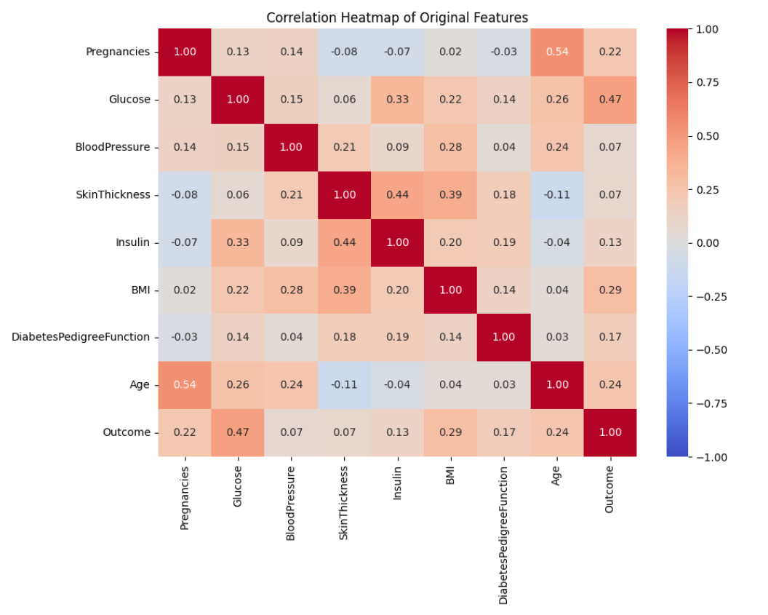
EDA
Statistical Analysis
Observation: Zeros found in Glucose, Insulin fields
Insights: Strong correlation between Glucose, BMI and diabetes
Notes:
• We conducted a thorough statistical analysis of the data, which revealed some interesting findings.
• First, we identified the presence of zeros in the Glucose and Insulin fields. This suggests there may be some missing or erroneous data that we'll need to investigate further.
• More importantly, our analysis uncovered a strong correlation between Glucose levels, BMI, and the presence of diabetes. This indicates there is a clear relationship between these key variables that we should explore in more depth.
• I'll dive into the specifics of these correlations and what they might mean for our understanding of the risk factors for diabetes in the next few slides.
6

Slide 7




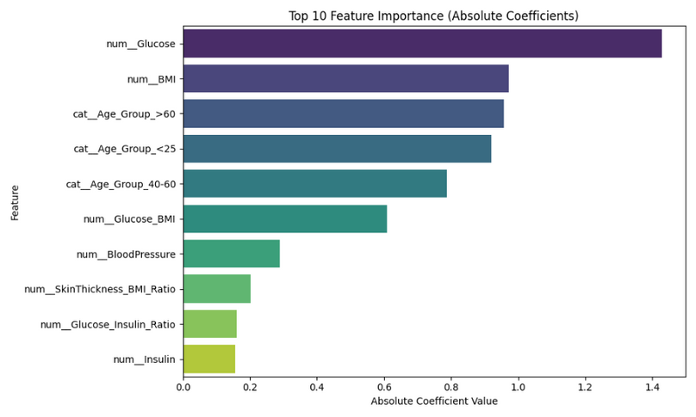
Feature Engineering & Model
Add Features
Drop Redundant
Glucose_BMI, Age_Group
Removed correlated variables
Train Model
Balance Data
Logistic Regression with StandardScaler
SMOTE for minority class
Notes:
We've added two new features to our dataset - Glucose_BMI and Age_Group. These provide additional information that can help our model make more accurate predictions.
Next, we removed some redundant variables that were highly correlated with each other. This helps reduce complexity and overfitting in our model.
To address the class imbalance in our data, we used SMOTE to synthetically generate more examples of the minority class. This ensures our model is trained on a more balanced dataset.
Finally, we trained a Logistic Regression model on the preprocessed data, using StandardScaler to normalize the input features. This is a common approach for classification problems like ours.
7

Slide 8
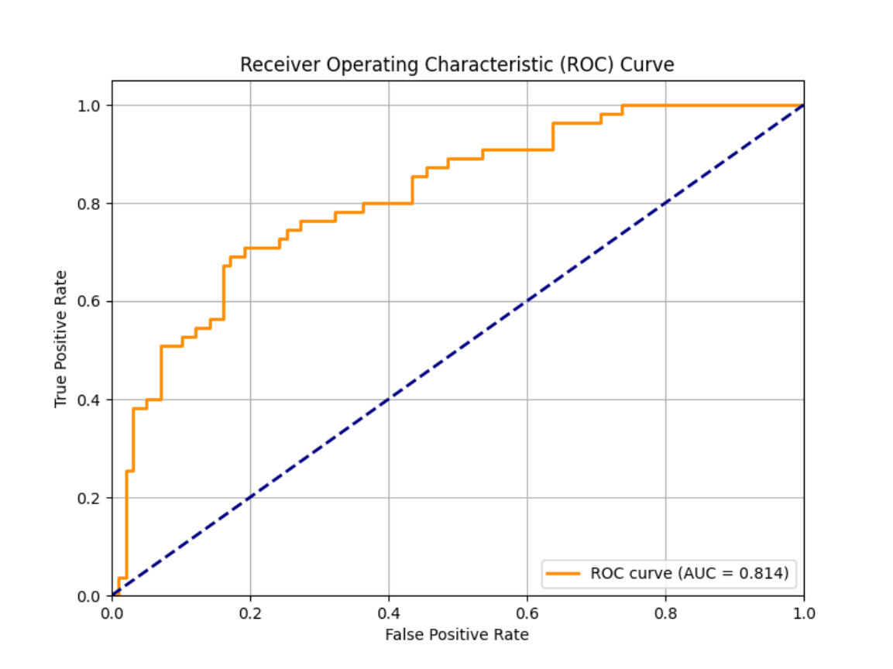
Fine Tuning
Tuned C with GridSearchCV (0.001–100)."
Best: C=1, CV AUC 0.8561.
Focus: Precision for fewer false positives.
Notes:
8

Slide 9
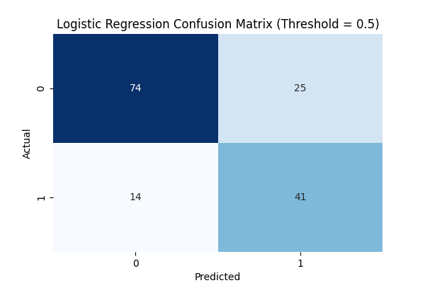
Model Performance
Confusion Matrix Highlights:
True Positives: 41 (74.55% recall)
False Positives: 25 (precision 0.6212)
Fewer false positives vs. recall-heavy model.
Notes:
The image on this slide provides a visual representation of the model's performance, including the ROC curve, confusion matrix, and key metrics.
The AUC score of 0.814 indicates the model has strong predictive power, able to distinguish between positive and negative cases.
The precision of 0.621 means the model is effective at reducing false positives, ensuring a high proportion of true positives among the predicted positives.
The recall of 0.746 shows the model is able to capture most of the actual positive cases, minimizing the number of false negatives.
The F1 score of 0.678 represents a balanced metric that considers both precision and recall, providing an overall assessment of the model's performance.
These metrics demonstrate the model's effectiveness and can be used to evaluate its suitability for the intended application.
9

Slide 10






Recommendations
Scale Up
Host on Streamlit Cloud
Expand Data
Add lifestyle factors
Test Models
Try XGBoost for higher AUC
Notes:
The key conclusions from our analysis are that we should focus on scaling up, expanding our data, and testing new machine learning models.
To scale up, we can host our application on Streamlit Cloud, which will allow us to easily deploy and share our work.
Expanding our data to include more lifestyle factors could help improve the predictive power of our models.
We should also experiment with XGBoost, a powerful tree-based algorithm, to see if we can achieve a higher AUC score.
These next steps will help us build on the progress we've made and take our project to the next level.
10

Slide 11
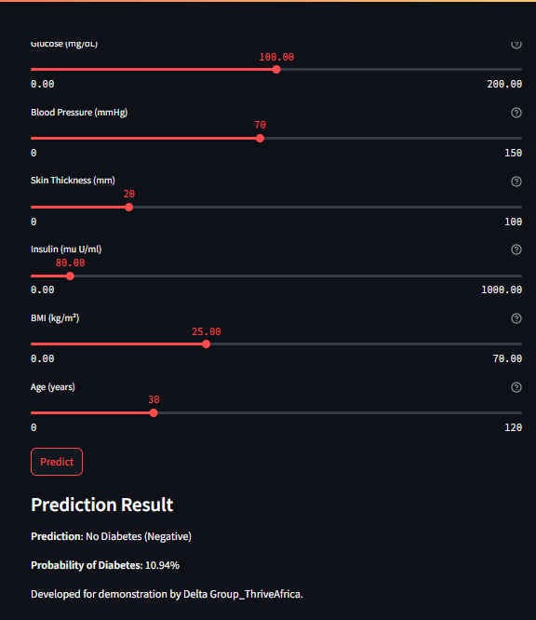
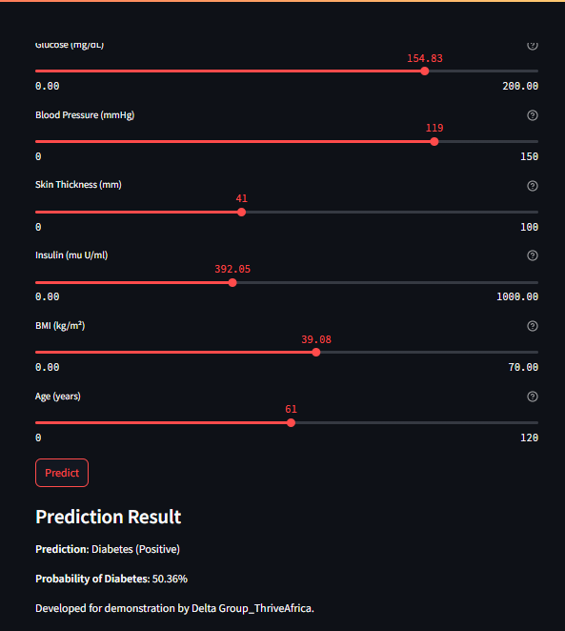
Conclusions
Delivered precise model (Precision 0.6212) & app.
Impact: Cuts false positives, demo-ready.
Future: Base for more diseases.
Notes:
11

Slide 12
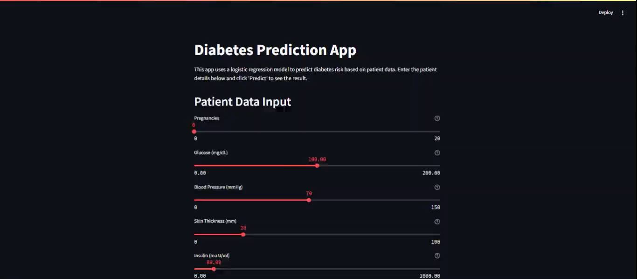
App Demo
Notes:
11

Slide 13
Questions and Answers
Notes:
12

Slide 14
Thank You
Notes:
13

